Slide 1



FAIR & OPEN
🔗
adapted and extended from: Biohackathon 2022 FAIR community update and x-meeting FAIRification hackathon 2023
TRAINING
Author: Bruna Piereck
Contributor: Alexander Botzki
Version: 092024
Notes:
🔗 means it is a link you can click

Slide 2


: fair
“
”
What you expect
What you deserve

Slide 3
FAIR principles
what do you think they mean ?
Findable:
Accessible:
Interoperable:
Reusable:
?
?

Slide 4

FAIR principles
what do you think they mean ?
!
Findable:
Accessible:
Interoperable:
Reusable:
Shared in a findable platform Human and Machine findable Linked to metadata
!

Slide 5

FAIR principles
what do you think they mean ?
!
Findable:
Accessible:
Interoperable:
Reusable:
!
How to access (Download and use) License or clear policy; Authentication (when necessary)

Slide 6

FAIR principles
what do you think they mean ?
!
Findable:
Accessible:
Interoperable:
Reusable:
!
Integrated data Interoperable in different resources Ideally general format compatible with many resources.

Slide 7
FAIR principles
what do you think they mean ?
!
Findable:
Accessible:
Interoperable:
Reusable:
!
Can be used/shared Can be manipulated/processed Can be analysed
as a whole or partially

Slide 8
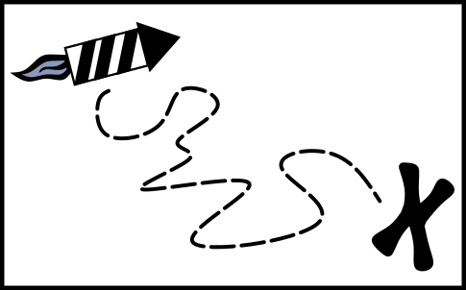
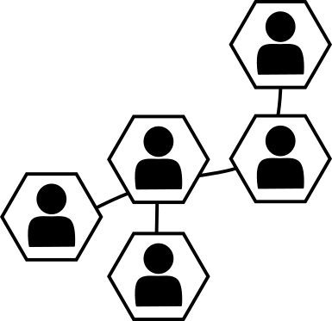


WHY TO GO FAIR ?
Improve access to all kinds of data; Training material included
Framework for consistent sharing
Best practice with the community
Icon by Freepik
Recognition of time and effort
Notes:
Icon by freepik: https://www.freepik.com/icon/hands_3483164#fromView=search&page=3&position=70&uuid=12f20466-2489-4c8c-8286-c68641d1ff79

Slide 9
FAIR principles
How do you translate for the TRAINING MATERIAL context?
Findable:
Accessible:
Interoperable:
Reusable:
?
?

Slide 10
Registered training
Assign Unique persistent ID
Keep in findable platforms
Use schemas for machine findability
FINDABLE
ACCESSIBLE
INTEROPERABLE
REUSABLE

Slide 11
Registered training
Assign Unique persistent ID
Keep in findable platforms
Use schemas for machine findability
FINDABLE
Define access rules
Annotate your training materia
Make metadata available
ACCESSIBLE
INTEROPERABLE
REUSABLE

Slide 12
Registered training
Assign Unique persistent ID
Keep in findable platforms
Use schemas for machine findability
FINDABLE
Define access rules
Annotate your training materia
Make metadata available
ACCESSIBLE
Can be used in different OS
Possibility to edit and re-use
Integrate in other resources
!
INTEROPERABLE
REUSABLE

Slide 13
Registered training
Assign Unique persistent ID
Keep in findable platforms
Use schemas for machine findability
FINDABLE
Define access rules
Annotate your training materia
Make metadata available
ACCESSIBLE
Can be used in different OS
Possibility to edit and re-use
Integrate in other resources
!
INTEROPERABLE
Can be used/shared
Can be modified
as a whole or partially
REUSABLE

Slide 14

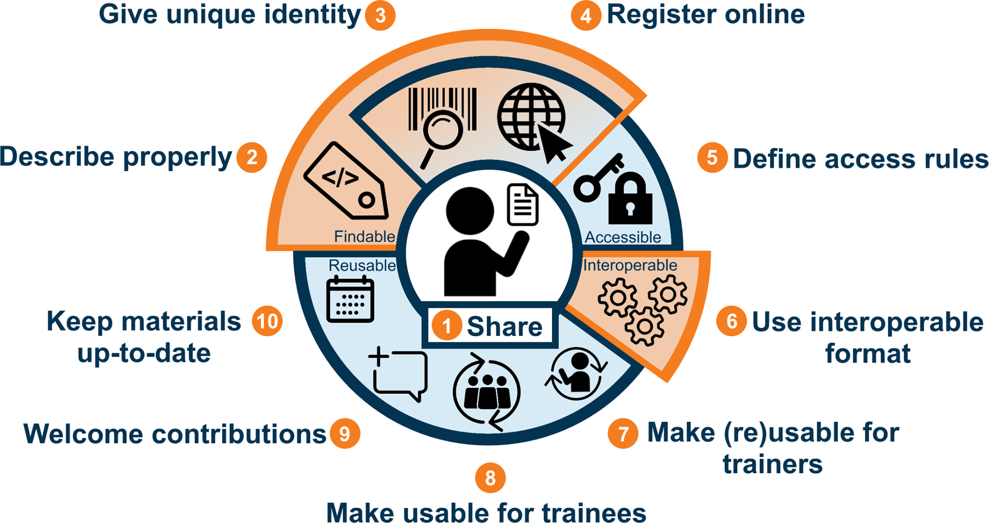


10 RULES FOR FAIR TRAINING
main goal
🔗
Image: 10 simple rules for making training materials FAIR

Slide 15



HOW DO I SHARE
Make it findable
Image: 10 simple rules for making training materials FAIR

Slide 16



HOW DO I SHARE
Make it findable
2
Describe properly
Standard metadata annotation
Key words
Audience
flaticon.com
Schemas.org
By Three Musketeers - Freepik
Notes:
Computer code by Three musketeers in Freepik: https://www.freepik.com/icon/arrange_15906312#fromView=search&page=1&position=4&uuid=74d2d834-33ad-48a8-b3b3-932aeb794543

Slide 17


HOW DO I SHARE
Make it findable
2
3
Describe properly
Give unique ID
Standard metadata annotation
Unique & Persistent (PID)
Key words
Audience
DOI (digital object identifier)
ORCID (open research and contributor ID)
PURL (persistent uniform resource locator)
flaticon.com
Schemas.org
By Three Musketeers - Freepik
Notes:
Computer code by Three musketeers in Freepik: https://www.freepik.com/icon/arrange_15906312#fromView=search&page=1&position=4&uuid=74d2d834-33ad-48a8-b3b3-932aeb794543

Slide 18


HOW DO I SHARE
Make it findable
2
3
4
Bioinfo, resources
Events
Material
Resources
Give unique ID
Describe properly
Describe properly
Standard metadata annotation
Unique & Persistent (PID)
Events
Material
Learning paths
Key words
Audience
DOI (digital object identifier)
ORCID (open research and contributor ID)
PURL (persistent uniform resource locator)
flaticon.com
Schemas.org
By Three Musketeers - Freepik
Notes:
Computer code by Three musketeers in Freepik: https://www.freepik.com/icon/arrange_15906312#fromView=search&page=1&position=4&uuid=74d2d834-33ad-48a8-b3b3-932aeb794543

Slide 19

HOW DO I SHARE
Make it accessible
Image: 10 simple rules for making training materials FAIR

Slide 20



HOW DO I SHARE
Make it accessible
5
Define access rules
License
Clear policy
Statement of use
Documentation
Metadata
Statement of accessibility
Request
Authentication
Paid

Slide 21
10 RULES FOR FAIRS TRAINING
Make it interoperable

Slide 22







HOW DO I SHARE
Make it interoperable
6
Mind the Format
Used in different contexts
(Re)-use
Fine-tune
Extend
Edit
Text material
Presentations
Videos
Others
Notes:
Pen & paper : Editable
Computer: works in every Operational system
V1-V3 papers: it is possible to have version control
People: Broadly used by the community, therefore easy to be re-used.
Others: git repo, data set, zenodo …

Slide 23

HOW DO I SHARE
Make it Reusable
Image: 10 simple rules for making training materials FAIR

Slide 24



HOW DO I SHARE
Make it Reusable
7 / 8
Make reusable
Annotation of:
Audience
Level
Prerequisites
Key words
Version
Authors
Etc …
License specifications for (re)-use
Annotations
Learning outcomes
Prerequisites
etc…
Annotate your slides
Slides need to be understandable without your presence
By Three Musketeers - Freepik
Notes:
Computer code by Three musketeers in Freepik: https://www.freepik.com/icon/arrange_15906312#fromView=search&page=1&position=4&uuid=74d2d834-33ad-48a8-b3b3-932aeb794543

Slide 25
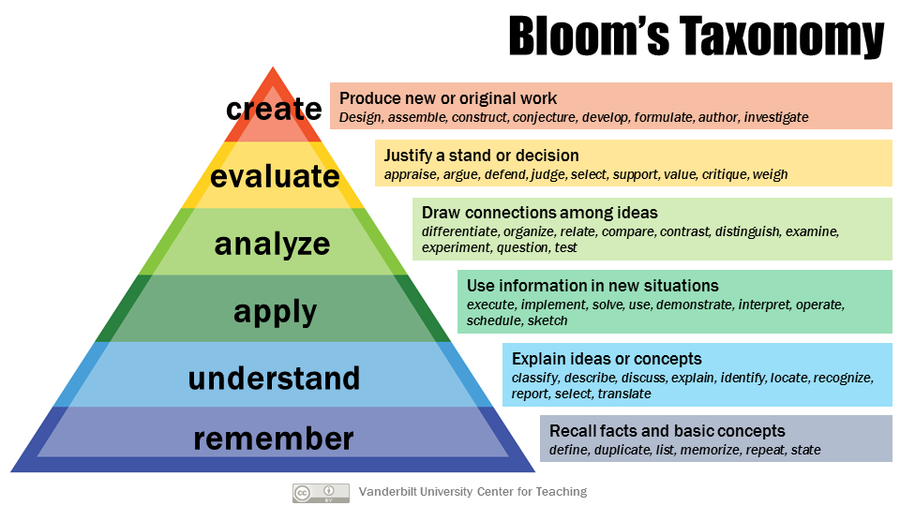
HOW DO I SHARE
Make it Reusable
7 / 8
Make reusable
Include the Learning outcomes
License specifications for (re)-use
Annotations
Learning outcomes
Prerequisites
etc…

Slide 26

HOW DO I SHARE
Make it Reusable
7 / 8
9
Make reusable
Welcome contributions
Collaboration file
License specifications for (re)-use
GitHub as collaborative tools
Annotations
Learning outcomes
Prerequisites
etc…
Acknowledgments & recognitions
By Three Musketeers - Freepik

Slide 27

HOW DO I SHARE
Make it Reusable
7 / 8
9
10
Make reusable
Welcome contributions
Keep up to date
Collaboration file
License specifications for (re)-use
GitHub as collaborative tools
Annotations
Learning outcomes
Prerequisites
etc…
Trends
Features
Resources version
Etc …
Acknowledgments & recognitions
By Three Musketeers - Freepik

Slide 28
All that is FAIR is OPEN and vice-versa
?
?

Slide 29

OPEN SCIENCE
Freepik.com
Open and transparent access broad public
Aiming reproducibility and re-use
Notes:
Yes we are open - by Freepick: https://www.freepik.com/free-vector/colorful-we-are-open-neon-sign_12236571.htm#fromView=search&page=2&position=34&uuid=277c04f8-af7a-403d-ab3f-54def2670bf5
Clowdy mind by Rawpixek in Freepick: https://www.freepik.com/free-photo/cloud-hidden-dilemma-depression-bliss_16462017.htm#fromView=search&page=2&position=2&uuid=efd2e130-ddcf-4a4b-83ca-755c41e08b18

Slide 30
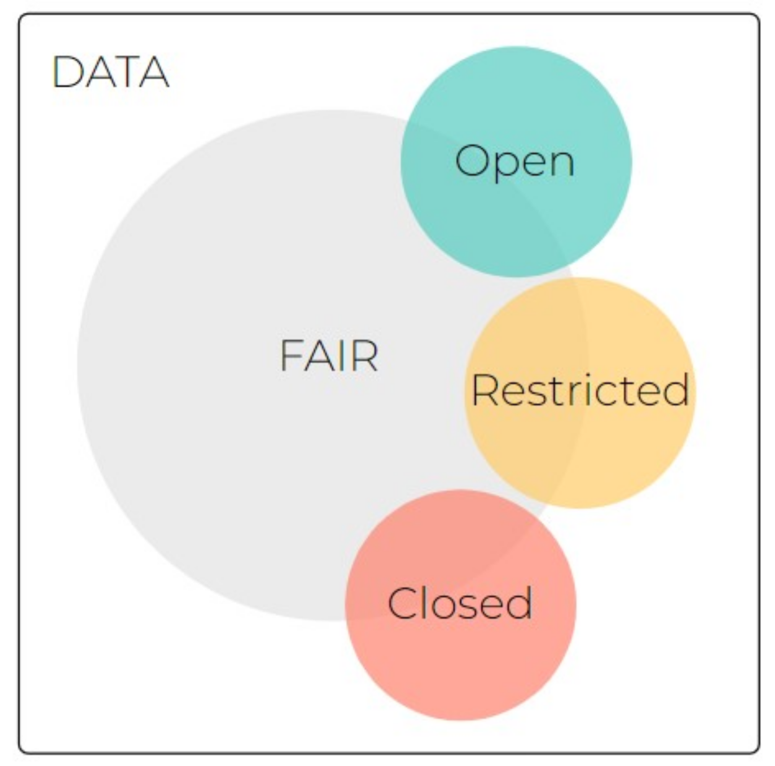
NO

Slide 31
5
Registered training
Assign Unique persistent ID
Keep in findable platforms
Use schemas for machine findability
Define access rules
FINDABLE
Define access rules
Annotate your training materia
Make metadata available
License
Clear policy
Statement of use
ACCESSIBLE
Can be used in different OS
Possibility to edit and re-use
Integrate in other resources
Request
Authentication
Paid
INTEROPERABLE
Can be used/shared
Can be modified
REUSABLE

Slide 32

“
as open as possible and
as close as necessary.
”
- Author unknown-
Rawpixel.com Freepik.com
Notes:
Yes we are open - by Freepick: https://www.freepik.com/free-vector/colorful-we-are-open-neon-sign_12236571.htm#fromView=search&page=2&position=34&uuid=277c04f8-af7a-403d-ab3f-54def2670bf5
Clowdy mind by Rawpixek in Freepick: https://www.freepik.com/free-photo/cloud-hidden-dilemma-depression-bliss_16462017.htm#fromView=search&page=2&position=2&uuid=efd2e130-ddcf-4a4b-83ca-755c41e08b18

Slide 33
COURSE PROJECT: Create a FAIR 5 min training material
Your training challenges for the next sessions:
Final goal:
Creating a FAIR material
Creating a 2 min course on a topic of your choice
Peaching this FAIR course material in the end of the course
2 min to peach the course
3 min to peach how you have achieved being FAIR
Show where you host the material
Your course should have by the end of the workshop:
Documentation for training
Annotation of training material
Choosing a hosting system for the material
Defining Authorship
Including illustration
Make a FAIR video
Annotate metadata
Giving unique identifiers

Slide 34

LET’S GET STARTED
LET’S GET STARTED
FINDABLE
ACCESSIBLE
INTEROPERABLE
REUSABLE
Image: 10 simple rules for making training materials FAIR
Notes:
Group 1
Identify who has contributed (ORCID - use or create one if needed)
Author
Contributor
Trainer
License type and specifications
1st step Metadata: audience, LO’s, programs, date, title, trainers, description, durations, contributors …
Group 2
FARIfy images, where to find open imagen and how to use it (They have to look for websites they can use) (Initiate …)
Who and How can other contribute to this material
Documento with activities links, descriptions to share with other trainers (Initiate …)
Last step
Tipos de version control -> type of material-set
To combine metadata and material in some way (think and discuss possibilities) -> README.md
Sharing/accessible : git, zenodo / Give an ID
Register TeSS
** After course
FARIfy images
Updated
Update for reusable formats
Activities and presentation description
Annotation for trainees to use the material for self learning

